Slide 1
Fresh Grads – Group Project
Online Flat Rental Application

Slide 2
Problem Statement
To Create an Application for Online Flat Rental
Customer should be able to view list of flats able to book flat.
Admin should be able to perform below operations:
1.Flat Management
2.Tenant Management
3.Flat Booking Management
4.User Management
5.Landrold Management

Slide 3
Road Map
Application will be developed in following Sprints –
Core Java +JPA with Hibernate
Spring Boot + Rest Controller + JPA with Hibernate
Angular for UI design (Front End) + Integration with previous Sprint

Slide 4
Plan
Design
Generate the skeleton as per class design provided
TDD approach
Identify test cases for each module
Write Failing Test cases
Convert the Test Cases in GREEN
Implement the case study in incremental manner

Slide 5
Modules
Login Module
Flat Booking Module
Flat Module
Land rold Module
Tenant Module
User Module

Slide 6
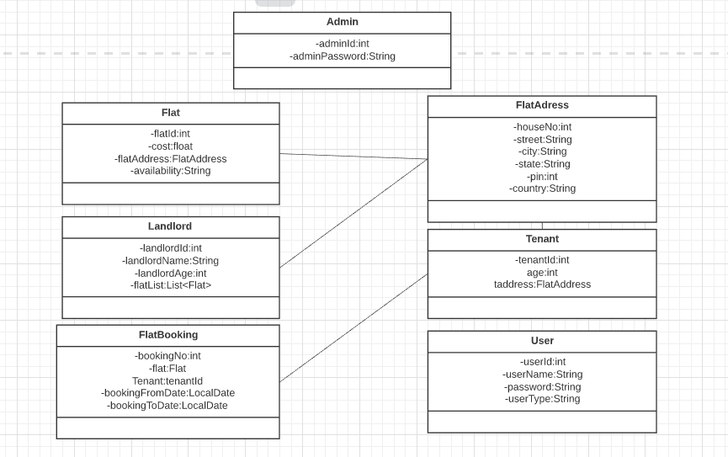
Class Design
POJO Classes:

Slide 7
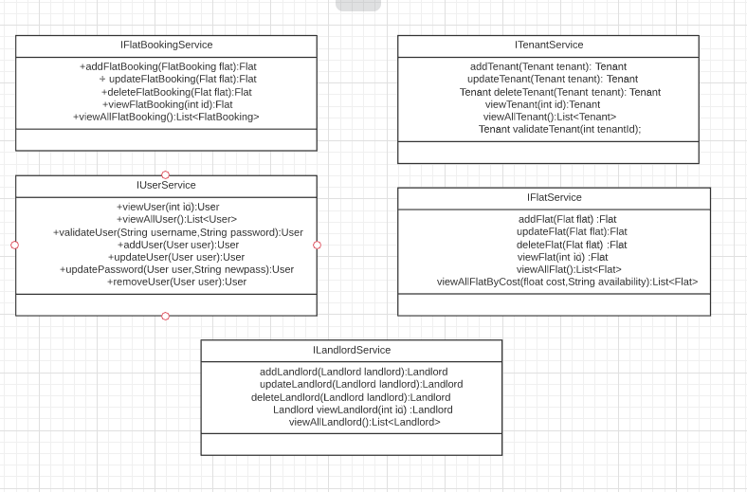
Service Interface:

Slide 8
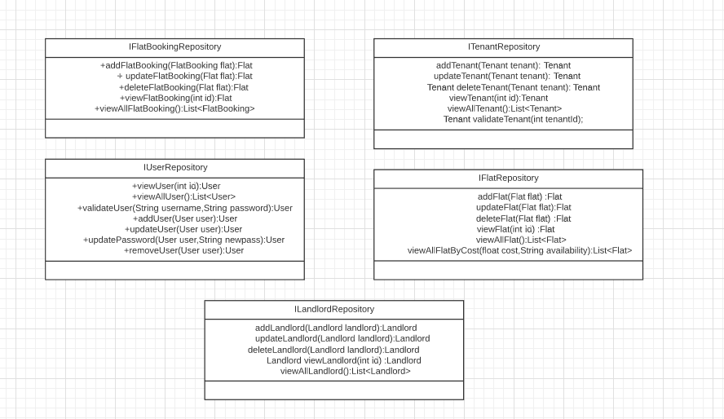
Class Design
Repository:

Slide 9




Questions

